Slide 1

Data Representation
Binary Arithmetic
Reference/Source - https://youtu.be/WbODFlqzSoc

Slide 2
Binary Addition
Rules :
0 + 0 = 0
0 + 1 = 1
1 + 0 = 1
1 + 1 = 0 , carry over 1 to the next column on the left

Slide 3
Example:
Binary
Decimal
1 1
10011
+ 1001
________
11100
19
+ 9
____
28

Slide 4
Example:
Binary
Decimal
1 1 1 1 1
100111
+ 11011
________
1000010
39
+27
____
66

Slide 5
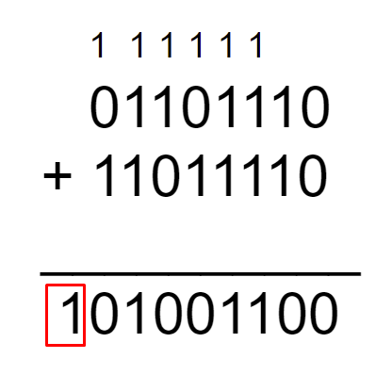
Overflow:
Add
01101110, and
11011110
Overflow Error
9th bit

Slide 6
Logical Binary Shifts:
Computers can carry out a logical shift on a sequence of binary numbers.
The logical shift means moving the binary number to the left or to the right.
Each shift left is equivalent to multiplying the binary number by 2 and each shift right is equivalent to dividing the binary number by 2.
As bits are shifted, any empty positions are replaced with a zero.

Slide 7
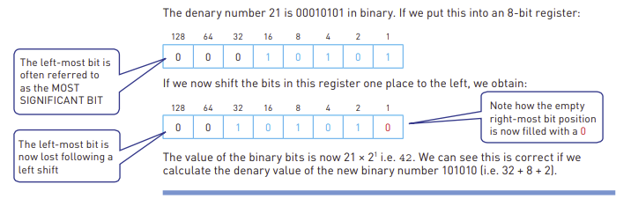

Slide 8
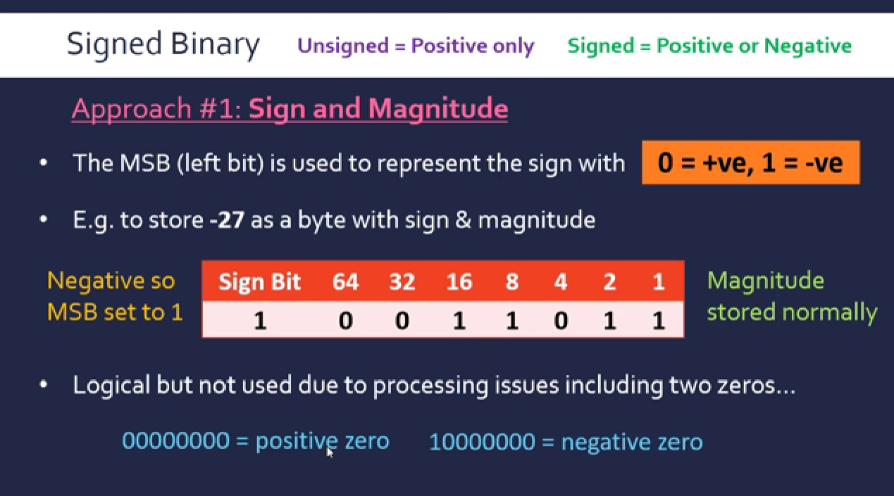

Slide 9
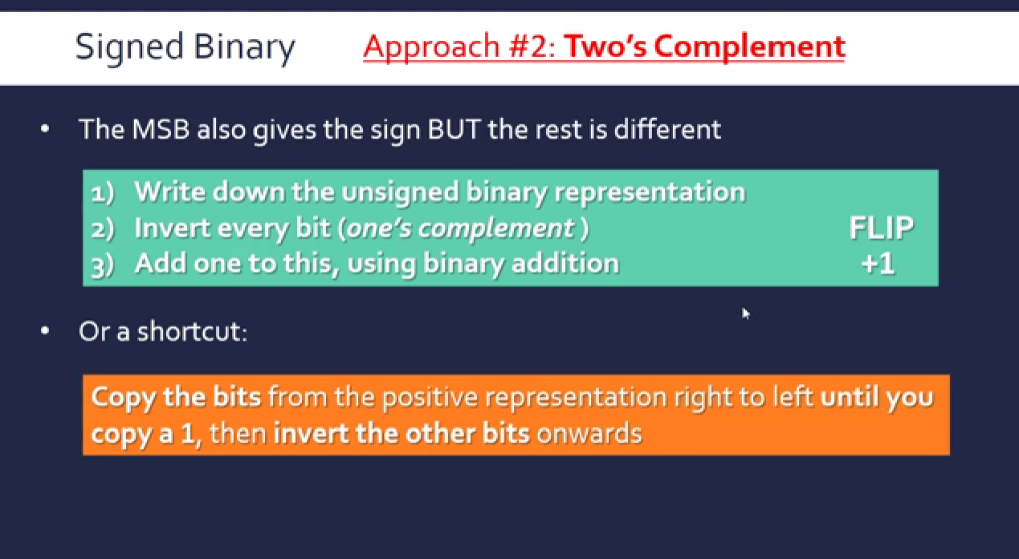

Slide 10
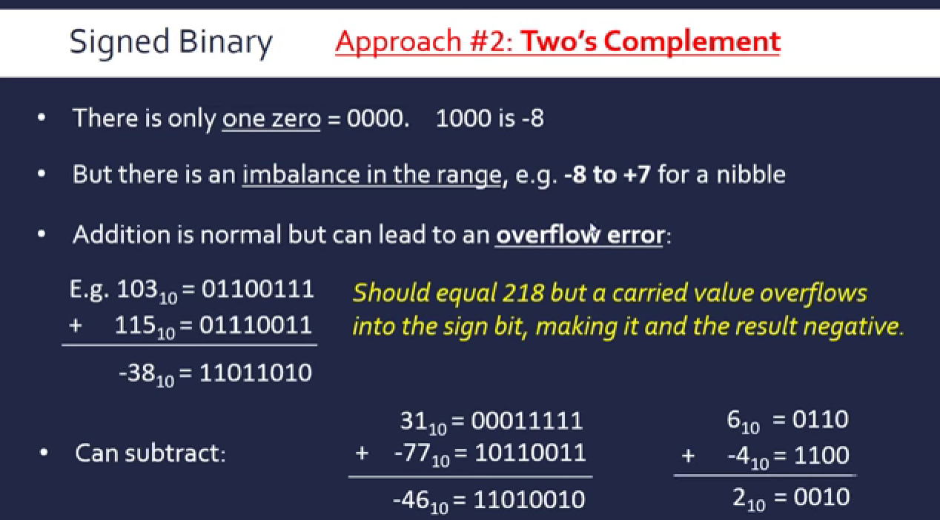

Slide 11
Quiz - https://forms.gle/buBoED37cxWuK9w38

